Slide 1

Capstone Project- Health Care
Soorej Kunnool Balan
PGP DSBA – June’21 Batch
01 July,2022

Slide 2
Business Problem Understanding
Business Problem
Health care is a critical domain for every individual as it directly links to well being of an individual and by extension his/her family.
Money plays a major role in this domain, because certain treatments are very expensive, and insurance helps to cover the risk.
If any individual is not covered under the insurance, then it will become a tough financial situation for that individual.
A health insurance risk pool is a group of individuals whose medical costs are combined to calculate premiums.
Pooling risks together allows the higher costs of the less healthy to be offset by the relatively lower costs of the healthy.
A risk pool with healthy individuals can result in lower-than-average insurance costs, a large pool with a large share of unhealthy individuals can have higher-than-average costs.
Hence the ability of the insurance company to assess the health/risk of its customer and correlate it to an optimal insurance cost is paramount.

Slide 3
Business Problem Understanding (continued)
Constraints
The main constraints faced by insurance companies are economic uncertainty, regulatory changes and risk of contagion.
Any of these could impact the insurance company’s ability to hedge the treatment cost of unhealthy individuals over perceived healthy individuals.
The model will consider existing data patterns provided and arrive at a prediction model. If the circumstances change and if new factors/features of importance emerges, the model’s efficacy will be severely impacted.
Scope
The scope of this business problem is limited to the data provided by the business.
No other external factors will be considered in the data analysis or model building phase.
The model building exercise will consider linear, non-linear and ensemble models to arrive at the best model based on performance factors such as Adjusted R-square and RMSE.
The exercise will evaluate the data over 10 regression models.

Slide 4
Business Problem Understanding (continued)
Objectives
Gain insights on the features using exploratory data analysis.
Treat the data in case of missing values, duplicates, outliers etc.
Consider all the features provided, such as health and habit related parameters, towards arriving at the estimated cost of insurance.
Build a predictive regression model, that can predict the optimum insurance cost for an individual with highest accuracy and in a cost-effective manner.
Provide recommendations to business based on the provided data.

Slide 5
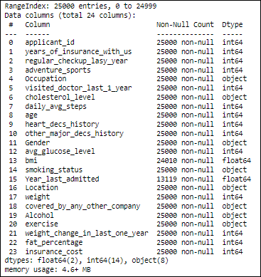
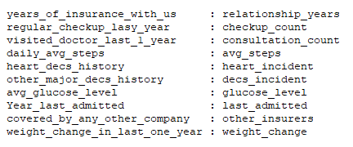
Insights from Analysis
Dataset provided by business has 25,000 rows(observations) across 24 columns (features).
Data has 14 integer, 2 float & 8 object features where the target variable is ‘insurance_cost’, a continuous variable.
Data has no duplicate rows.
2 columns have missing values – ‘bmi’ & ‘Year_last_admitted’.
Below columns will be renamed as follows:

Slide 6
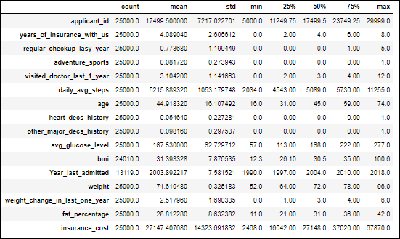
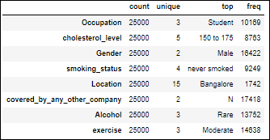
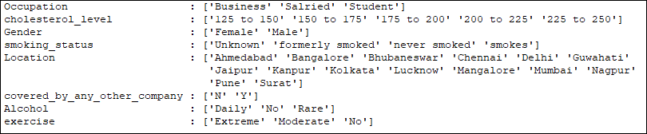
Insights from Analysis (continued)
Detailed summary of numerical columns
Detailed summary of categorical columns

Slide 7
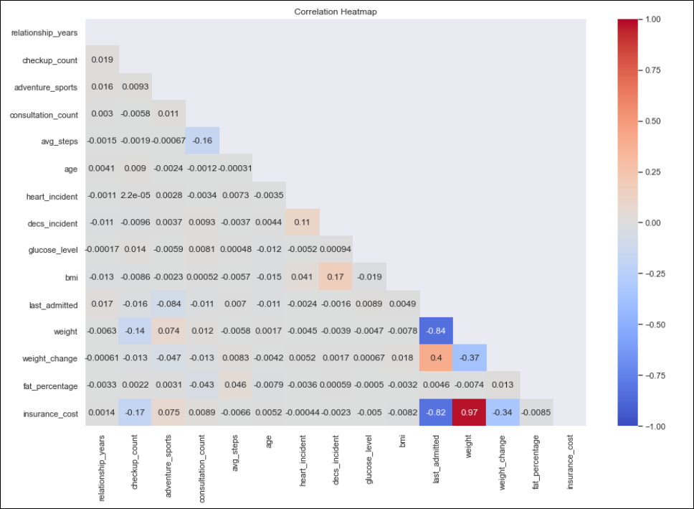
Insights from Analysis (continued)
Correlation Heatmap
Weight has an almost perfect positive correlation with insurance_cost.
last_admitted has a high negative correlation with weight and insurance_cost.
Weight_change has a moderate negative correlation with insurance_cost.
Interaction between all other numerical features are minimal and can be disregarded.

Slide 8
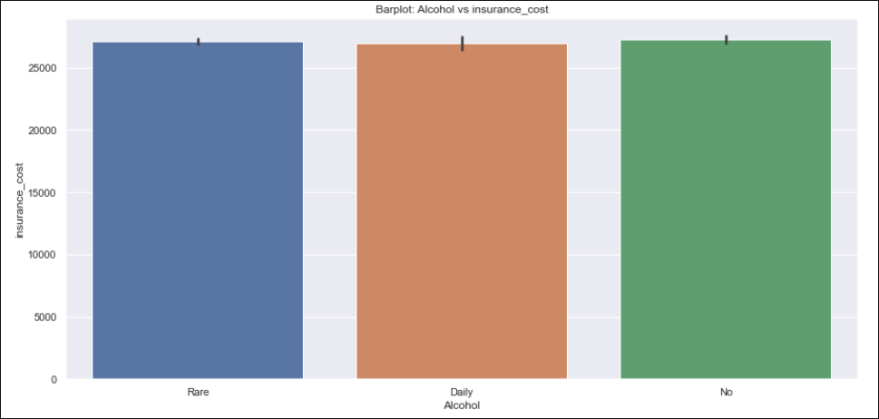
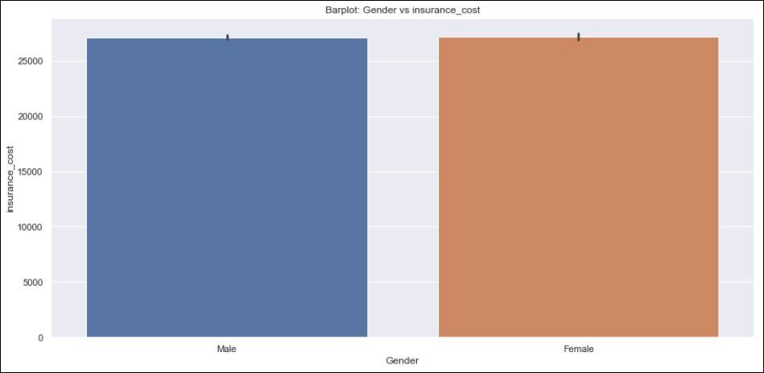
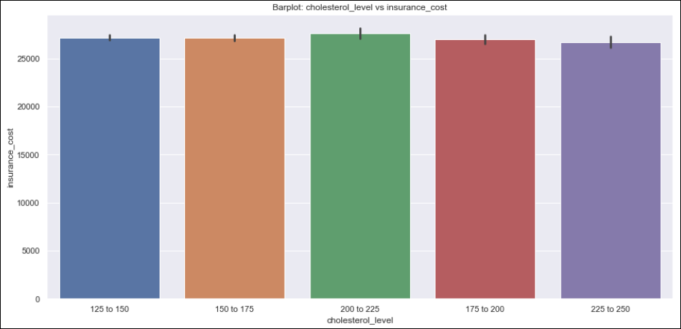
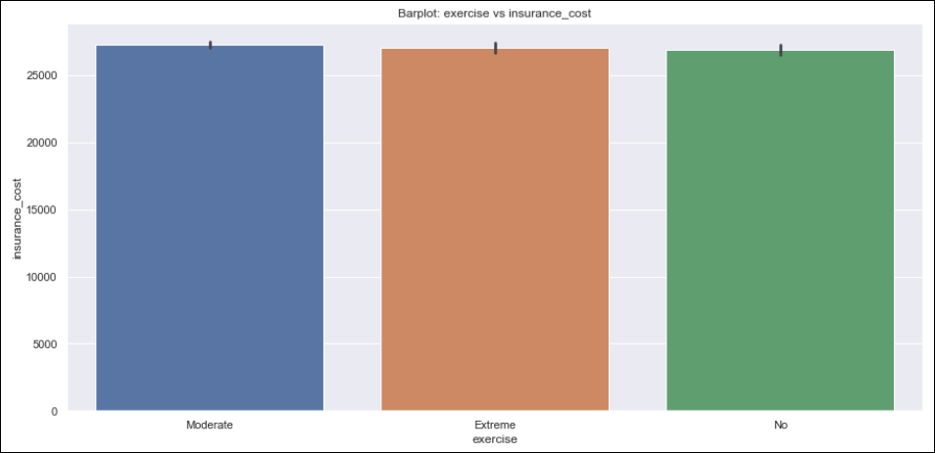
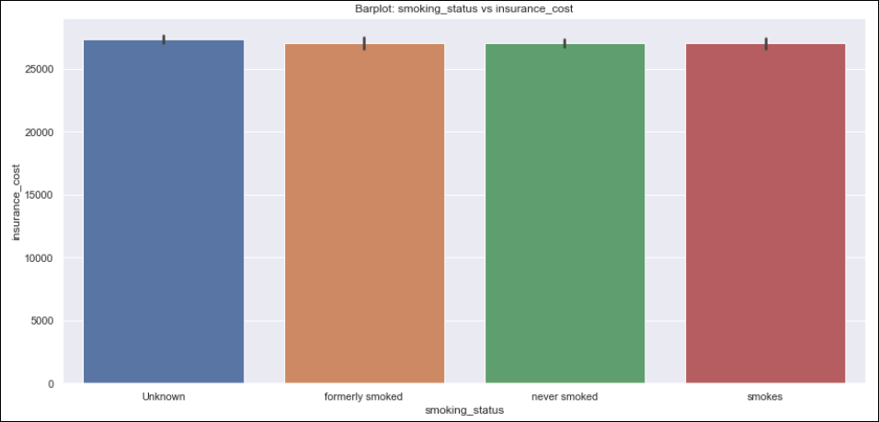
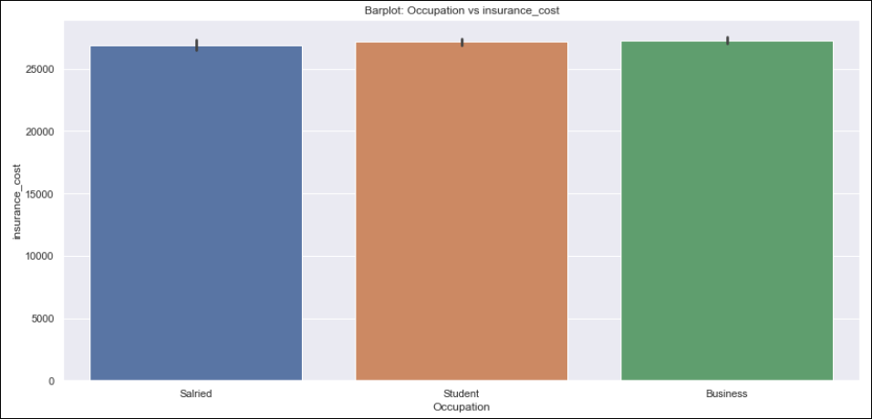
Insights from Analysis (continued)
Surprisingly, average insurance cost across categorical variables such as ‘Alcohol’(consumption), ‘cholesterol_level’, ‘smoking_status’, ‘gender’, ‘exercise’, ‘occupation’ remained more or less the same.

Slide 9
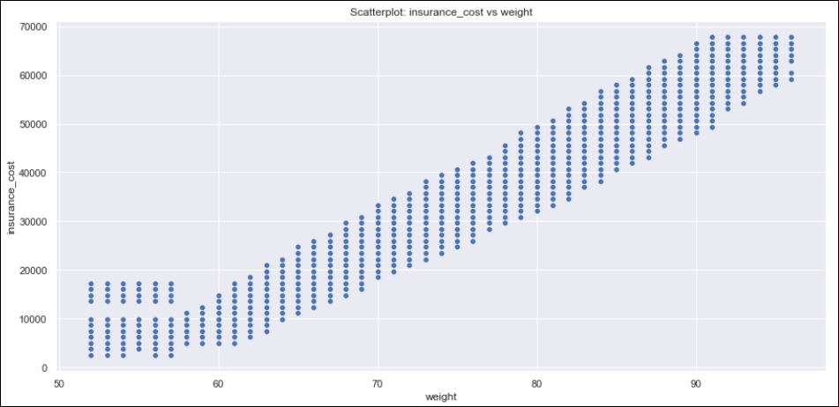
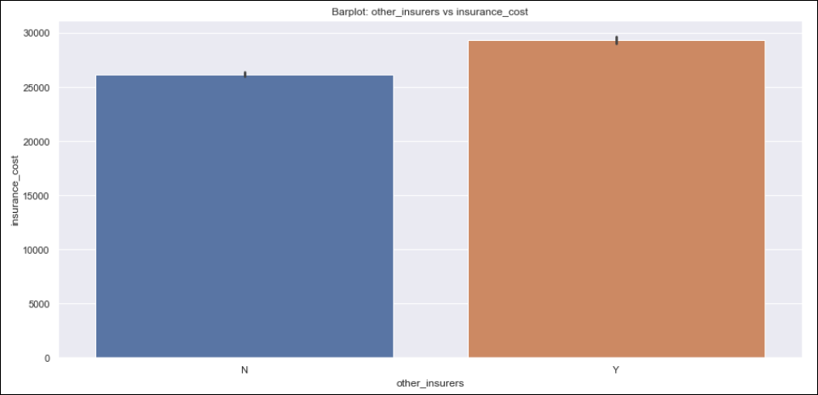
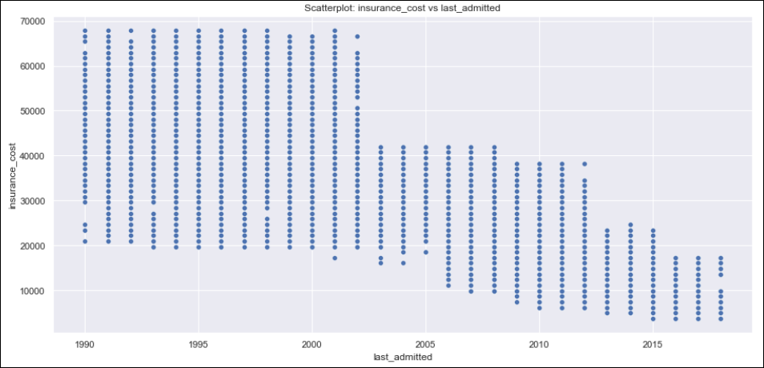
Insights from Analysis (continued)
The only categorical variable across which the target variable ‘insurance_cost’ showed some variation is ‘other_insurers’, i.e. for customers who have opted for insurance from other companies the average insurance cost is higher than those who did not.
As weight increases insurance_cost increases and as the last_admitted year is older insurance_cost rises.

Slide 10
Modeling Approach
Following steps were performed prior to model building
Null value treatment
Removed observations where ‘bmi’ has missing values. 990 rows out of 25,000.
last_admitted column’s missing values seems to be valid, hence substituted with 0.
Variable transformation
3 features, namely heart_incident, decs_incident and adventure_sports are given as integer columns with values 0 and 1. These are in fact categorical variables and the column values are replaced with N and Y, corresponding to 0 and 1.
Standardization
The numerical columns are scaled using Standard Scaler.
Dummy encoding
The categorical variables are dummy encoded, in order to run through the various machine learning models.

Slide 11
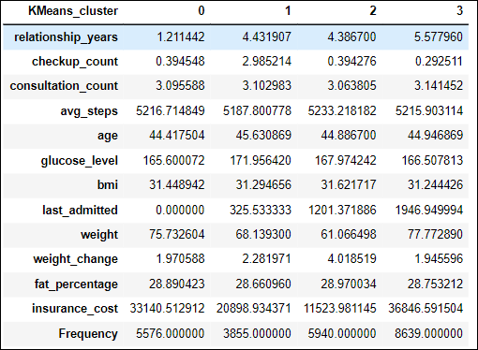
Modeling Approach (continued)
K-Means clustering
We will attempt to cluster the scaled and dummy encoded data using K-Means clustering. The data was grouped into 4 clusters as Low (cluster 2), Medium (cluster 1), High (cluster 0) and Very High (cluster 3) risk customers (from an insurance_cost perspective).
Train –Test split
We will use the above K-Means cluster information to ensure that the train and test dataset maintains the same cluster ratios, in order to avoid bias while training the model.
Since our target variable, insurance_cost is a continuous variable, we will be looking at various regression models to train and test.
We will evaluate the model performance of linear, non-linear and ensemble regression models and choose the best model based on parameters such as Adjusted R-square, RMSE(Root Mean square) etc.

Slide 12
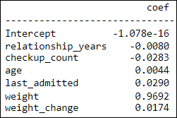
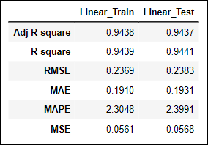
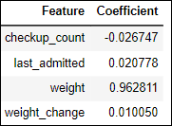
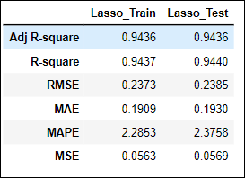
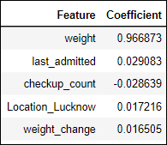
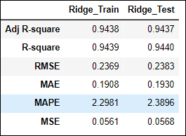
Modeling Approach (continued)
Linear Regression Models.
Linear Regression using ordinary least square method of statsmodel. The model has good performance and is neither an overfit or underfit.
Lasso Regression – Regularized linear regression with L1 penalty. The model was hypertuned via GridSearchCV. The model has good performance and is neither an overfit or underfit.
Ridge Regression – Regularized linear regression with L2 penalty. The model was hypertuned via GridSearchCV. The model has good performance and is neither an overfit or underfit.
Feature Importance
Performance Metrics

Slide 13
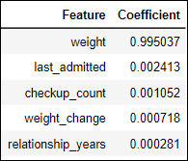
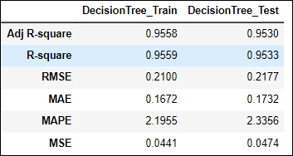
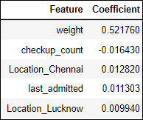
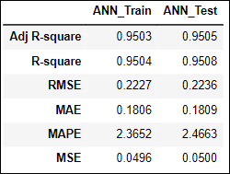
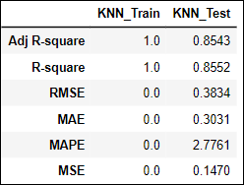
Modeling Approach (continued)
Non-Linear Regression Models.
DecisionTree regression with model parameters hypertuned via GridsearchCV. The model has good performance and is neither an overfit or underfit.
Artificial Neural Network– implemented via Multi Level Positron regression. The model was hypertuned via GridSearchCV. The model has good performance and is neither an overfit or underfit.
KNN Regression – K nearest neighbor regression. The model was hypertuned via GridSearchCV. The model is clearly overfit, and we will not be considering this model further.
Feature Importance
Performance Metrics

Slide 14
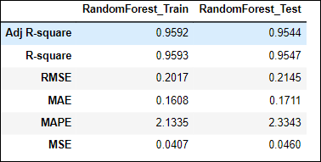
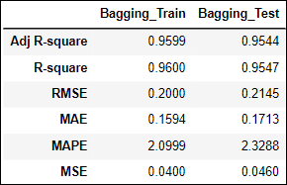
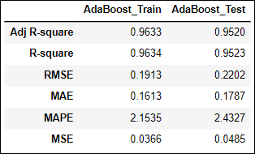
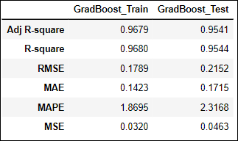
Modeling Approach (continued)
Ensemble Regression Models.
Random Forest regression model with parameters hypertuned via GridsearchCV. The model has good performance and is neither an overfit or underfit.
Bagging Regression model with Random Forest as base estimator and hypertuned via GridSearchCV. The model has good performance and is neither an overfit or underfit.
ADABoost Regression model with DecisionTree Regressor as base estimator and hypertuned via GridSearchCV. The model has good performance and is neither an overfit or underfit.
GradientBoosting regressor model hypertuned via GridSearchCV. The model has good performance and is neither an overfit or underfit.
Performance Metrics

Slide 15
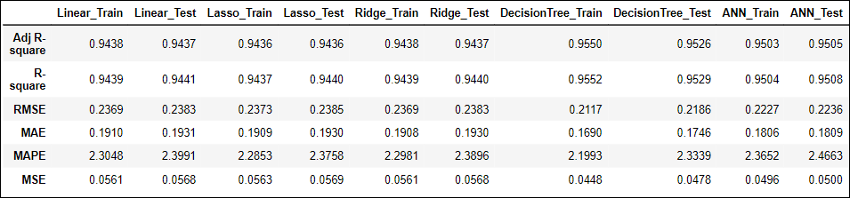
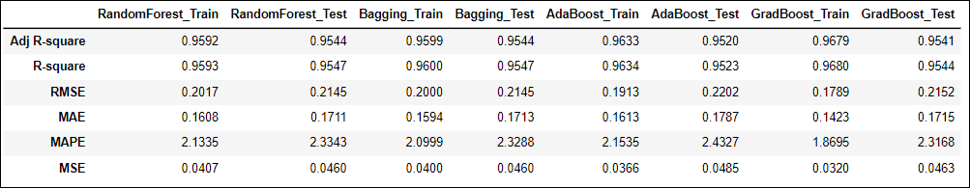
Modeling Approach (continued)
Comparing the performance of all the models.
-Adjusted R-square value is highest for test datasets of Random Forest and Bagging.
-Random Forest train/test datasets values are closer; hence RF has the best performance.
-Linear Regression is at par with RF model (with Adjusted r-squared difference of less than 0.0107).
-Linear Regression are less complex & faster to execute resulting in lower execution costs.
-Hence, we can consider linear regression as the best model of the lot.

Slide 16
Recommendations
Linear regression is the optimum model to predict insurance costs for the given features, as it has comparable performance with all other models(Random Forest has the highest performance of all models, but RF model is complex and time consuming in real world scenarios with large datasets).
Linear regression in this scenario can be expressed as a function of predictor and target variables as follows:
insurance_cost = -1.078e-16 + (0.9692)weight + (0.0290) last_admitted + (0.0174) weight_change+
(0.0044) age – (0.0283) checkup_count – (0.008) relationship_years
Weight is the most significant of features in determining the insurance cost.
Other features of importance are last_admitted, weight_change, age, checkup_count and relationship_years.
Considering weight (taken at time of enrollment) to be the most important feature might not be optimal. Height should also be taken into consideration. A better factor to weigh insurance_cost should be BMI or body fat percentage, which gives a better indication of patient’s health.
Smoking is also a huge factor in most of the health issues, insurance cost should be heavily correlated to smoking habits, which can be identified via blood tests. This would promote health lifestyle for the customers.

Slide 17
Recommendations (continued)
Age, even though present in the dataset and in the important feature, the correlation seems to be weak. This is another factor that business needs to reconsider.
Being in the age of digital revolution and widespread use of smart bands/watches, the company should promote healthy lifestyle with brownie points for more steps walked over a period, which can be sourced from the members smart watch information.
The dataset seems to have missed critical information such as frequency and amount of past claims, which should have a considerable impact on the insurance cost.
Even though we have information on customers covered by any other company, we should have insights on why the cover with one company is not enough based on the customers' profile.
Dependents information is also not provided, though these might be individual insurances, this needs to be clarified with business.

Slide 18
~Thank You~

